Slide 1
Section M
Nitrogen metabolism
Guodong Yang
Biochemistry and Molecular Biology, College of Life Sciences
gdyang@sdau.edu.cn
13854808762

Slide 2
Section M
Nitrogen metabolism
1. Reduction of N₂ into ammonia (NH₃ or NH₄⁺)
2. Synthesis of the 20 amino acids.
3. Amino acid degradation

Slide 3
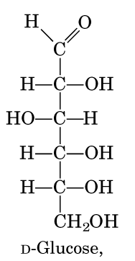
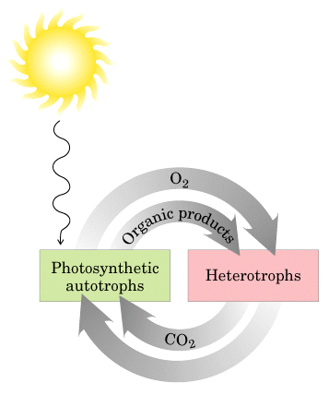
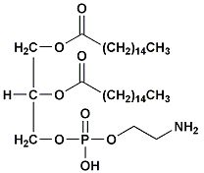
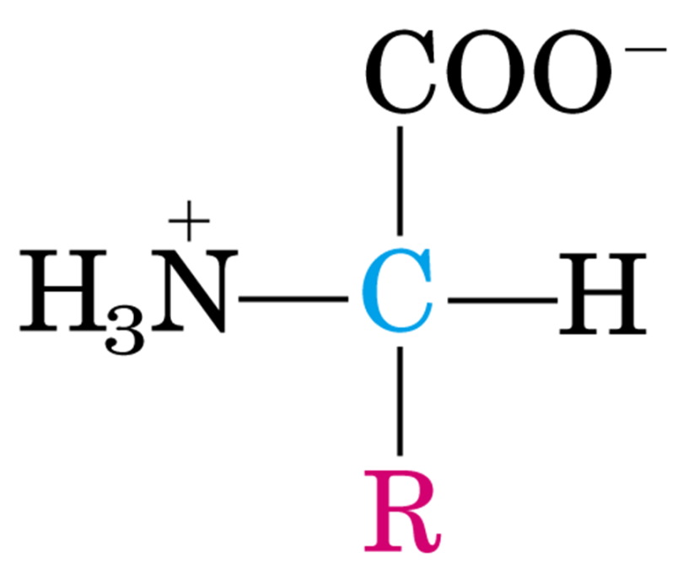
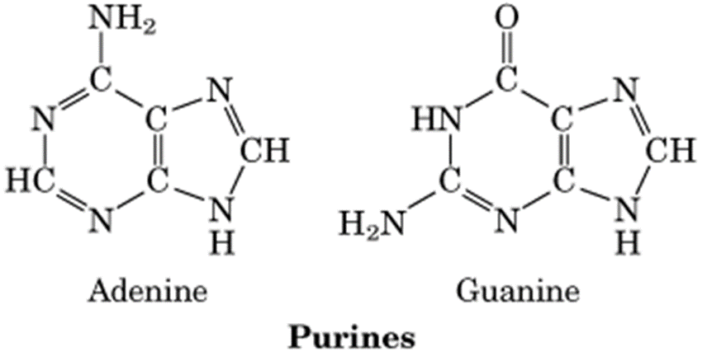
N2
H2O
O2

Slide 4
M1 Nitrogen fixation and assimilation
The nitrogen cycle
Nitrogen fixation
Nitrogen assimilation

Slide 5
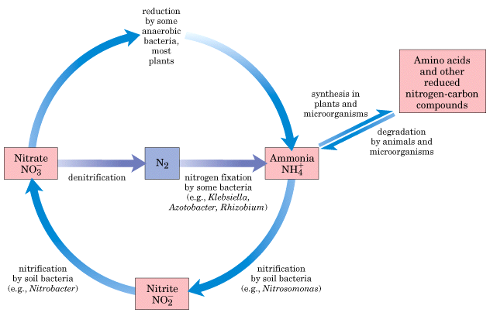
Ammonia assimilation
Nitrogen fixation
Next

Slide 6
The nitrogen in amino acids, purines, pyrimidines and other biomolecules ultimately comes from atmospheric nitrogen.
Cyanobacteria (蓝藻细菌, photosynthetic) and rhizobia (根瘤菌, symbiont) can fix N₂ into NH₃.
The reduction of N₂ to NH₃ is thermodynamically favorable :
N₂ + 6e⁻ + 6H⁺ 2NH₃ ΔG`º = -33.5kJ/mol

Slide 7
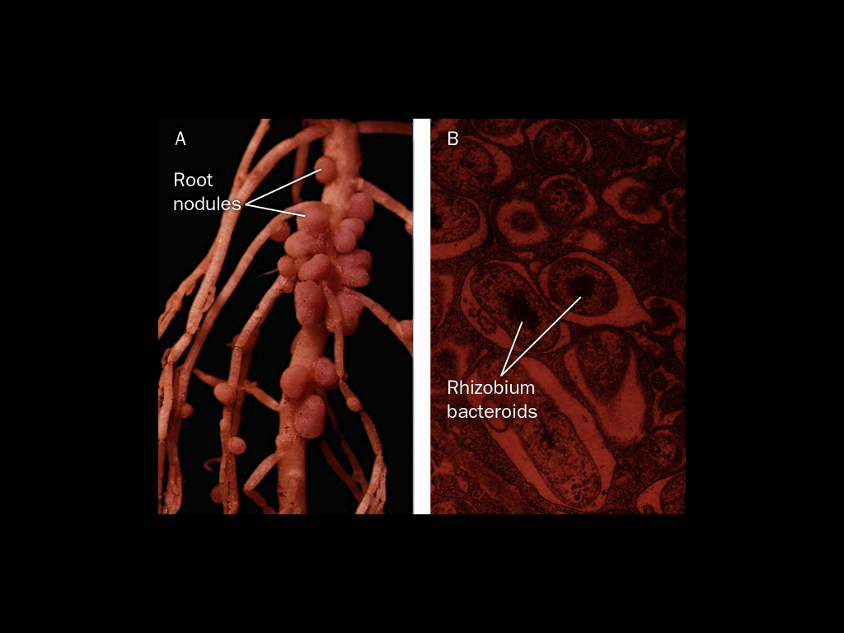
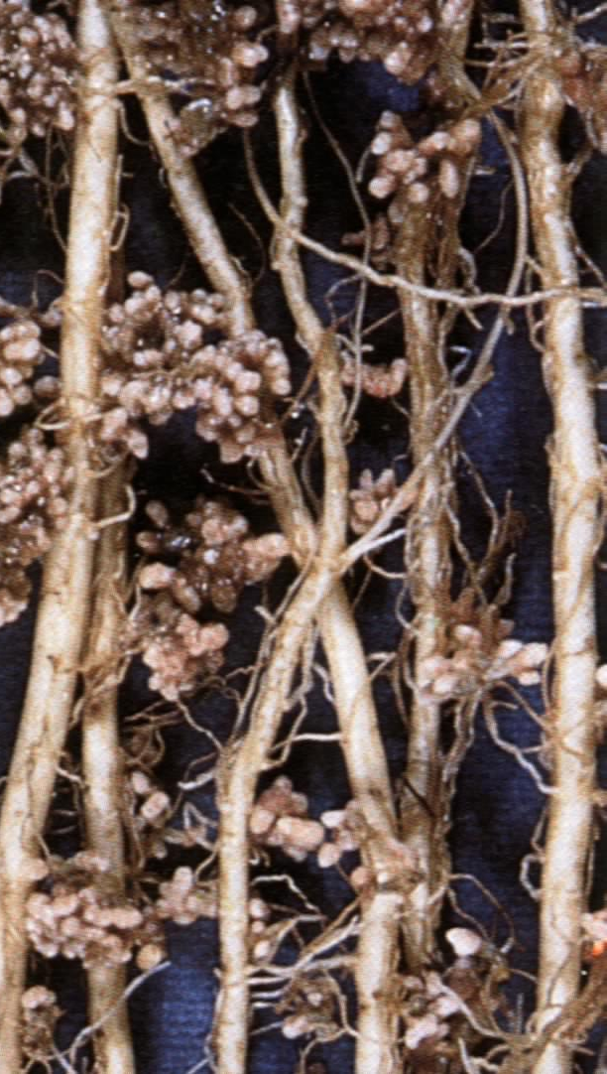
Certain bacteria can fix N₂ into ammonia

Slide 8
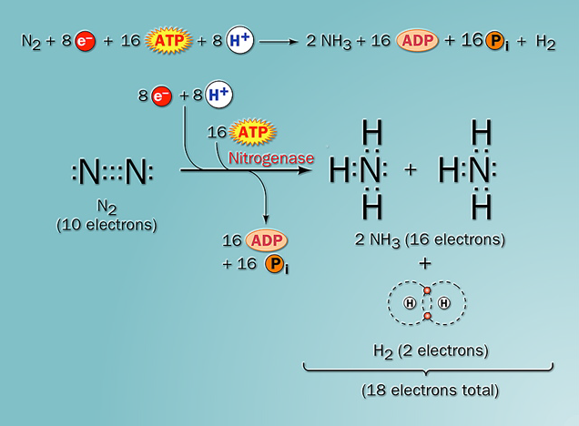

Slide 9
Nitrogen fixation
The nitrogenase complex in certain bacteria catalyzes the conversion of N₂ to NH₃, which is the ultimate source of nitrogen for all the nitrogen-containing biomolecules.
Next

Slide 10
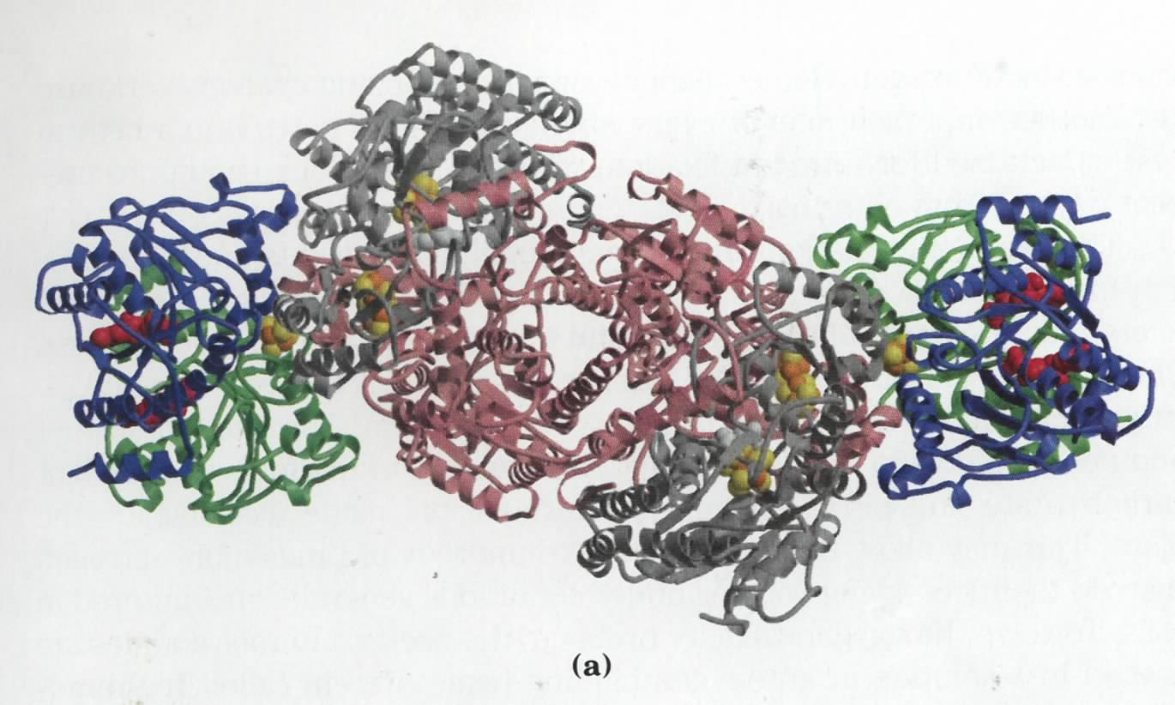
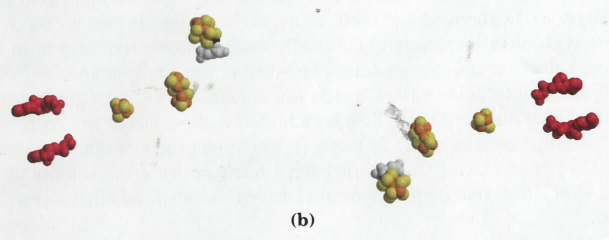
The nitrogenase complex consists of
dinitrogenase and dinitrogenase reductase
e⁻
?
Fe-Mo cofactor
4Fe-4S
(P-cluster)
ADP
ADP
4Fe-4S
4Fe-4S
4Fe-4S
(P-cluster)
ADP
ADP
Fe-Mo cofactor

Slide 11
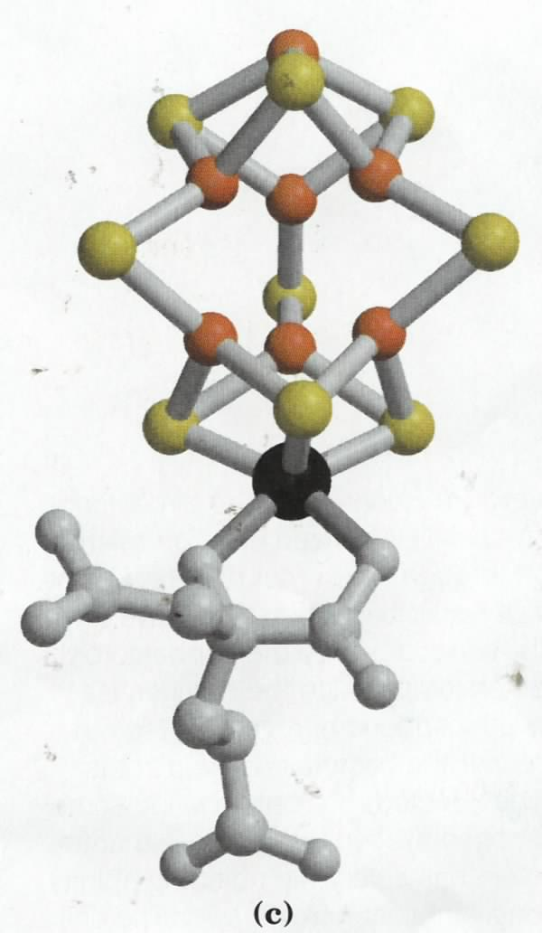
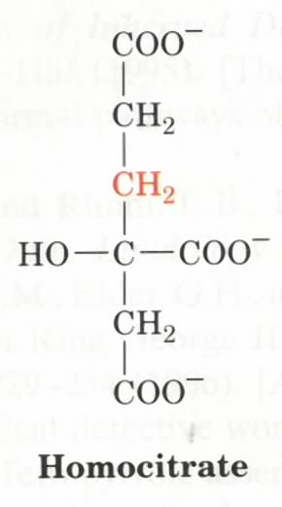
Fe
S
N₂ is believed to
be reduced at the
Fe-Mo cofactor
S
S
Fe
Fe
Fe
N₂
S
S
S
Fe
Fe
Fe
S
S
S
Mo
Molybdenum

Slide 12
Electrons are transferred through a series of carriers to N₂ for its reduction on the nitrogenase complex
N₂ + 8H+ +8e- + 16ATP + 16H₂O
→ 2NH₃ + H₂ + 16ADP + 16P_{i}

Slide 13
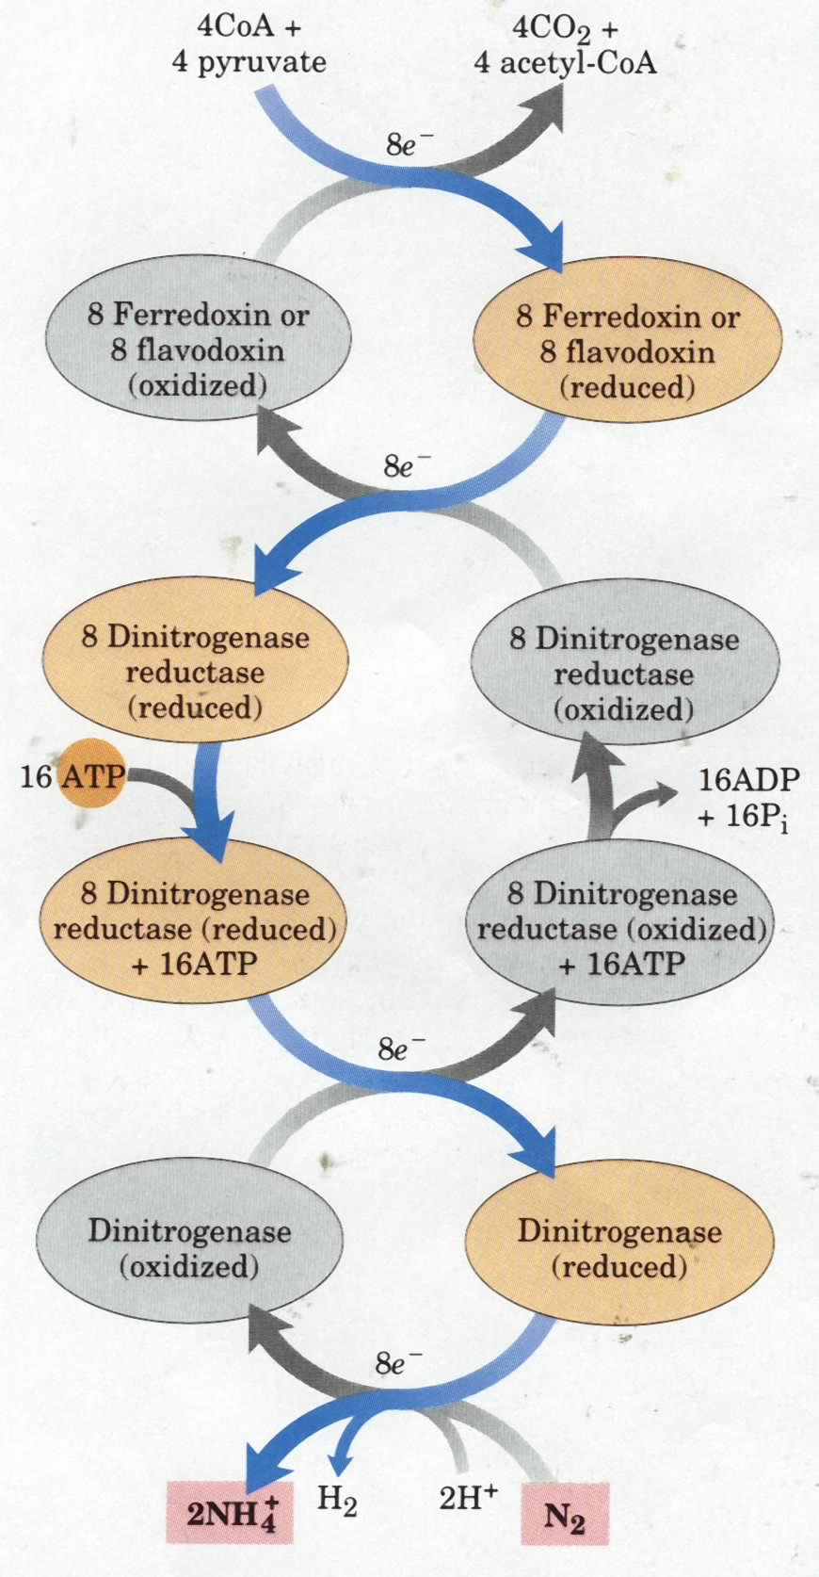
Electrons are
transferred
to N₂ bound in
the active site
of dinitrogenase
via ferredoxin/
flavodoxin and
dinitrogenase
reductase

Slide 14
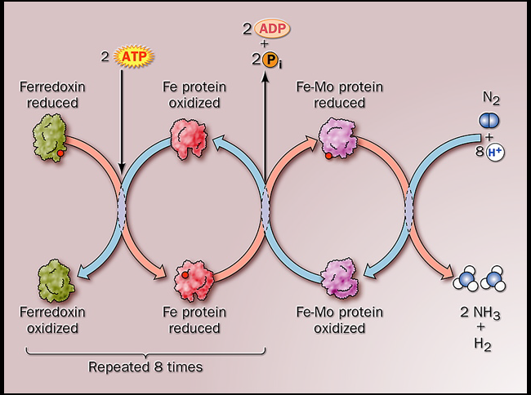

Slide 15
M2 Amino Acid Metabolism
Biosynthesis of amino acids
Amino acid degradation
Transamination
Oxidative deamination of glutamate
Amino acid oxidation
Metabolism of phenylalamine

Slide 16
Reduced nitrogen in the form of NH₄⁺ is assimilated into organic nitrogen-containing compounds by the action of glutamate dehydrogenase and glutamine synthetase .
Ammonia assimilation
Ammonia is incorporated into biomolecules through Glutamate and glutamine.

Slide 17
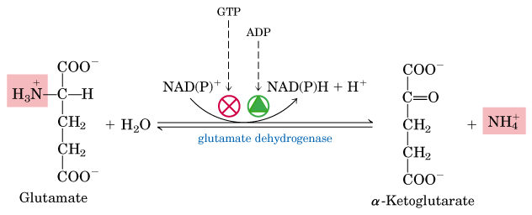
glutamate dehydrogenase

Slide 18
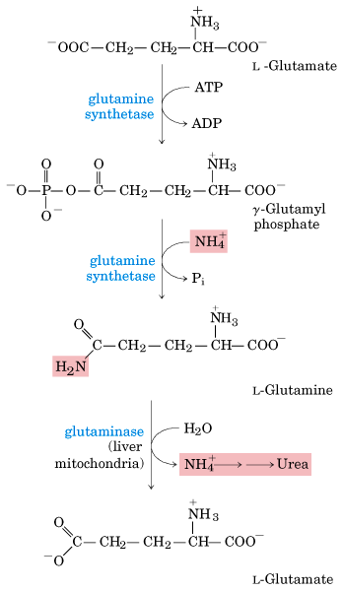
glutamine synthetase

Slide 19
glutamine synthetase
Glutamate + NH3 +ATP Glutamine + ADP + Pi
Glutamine + Ketoglutarate 2Glutamate
Glutamate synthase
NADPH NADP⁺
形成Gln既是氨同化的一种方式，又可消除过高氨浓度带来的毒害，还可以作为氨的供体，用于Glu的合成。

Slide 20
Biosynthesis of amino acids
The amino acids can be grouped into six biosynthetic families depending on the metabolic intermediate from which their carbon skeleton is derived.

Slide 21
The 20 amino acids are synthesized mainly from intermediates of glycolysis, citric acid cycle, or pentose phosphate pathway in bacteria and plants.

Slide 22
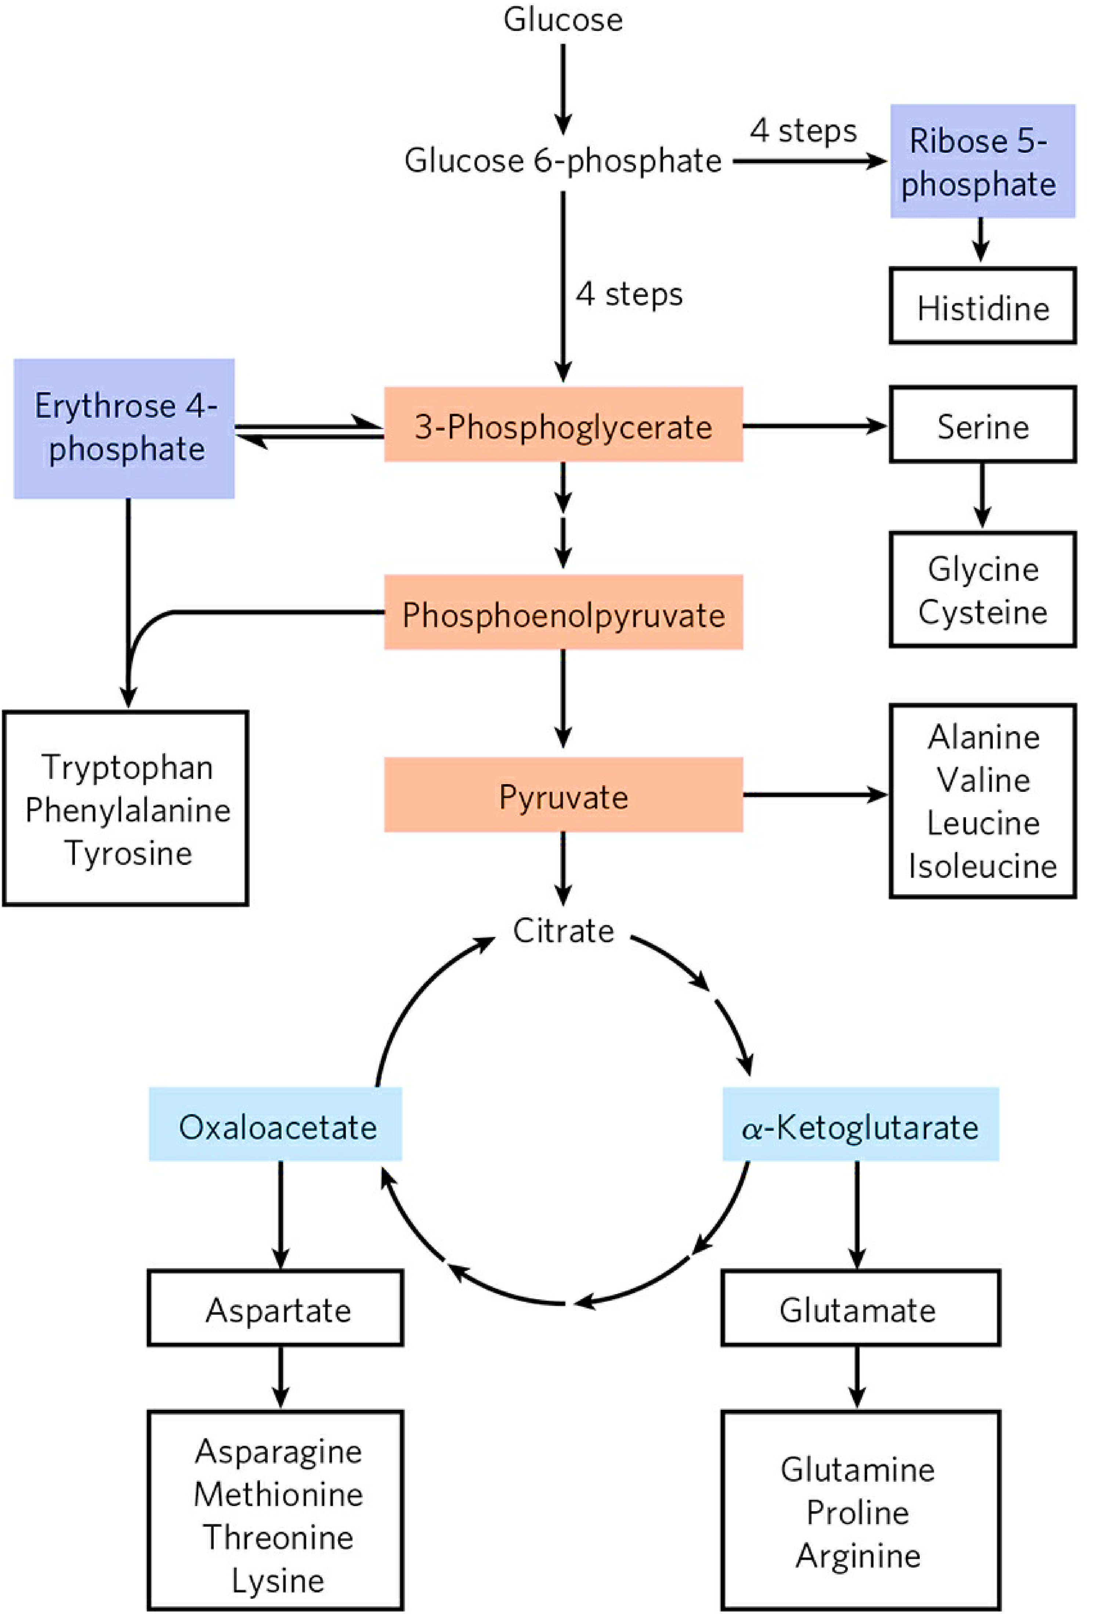
aromatic
7th edition
Next

Slide 23
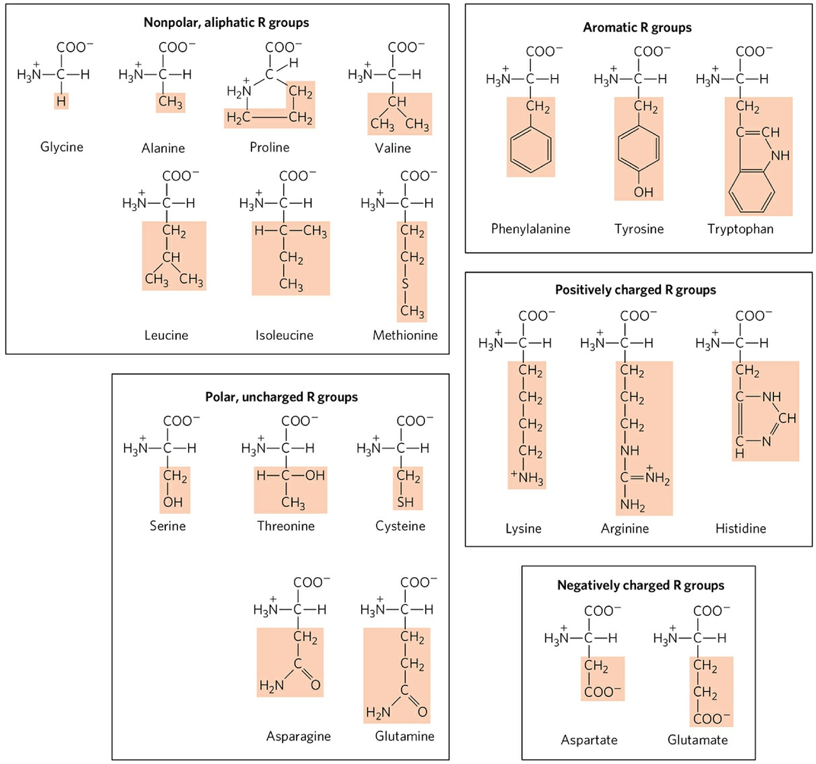

Slide 24
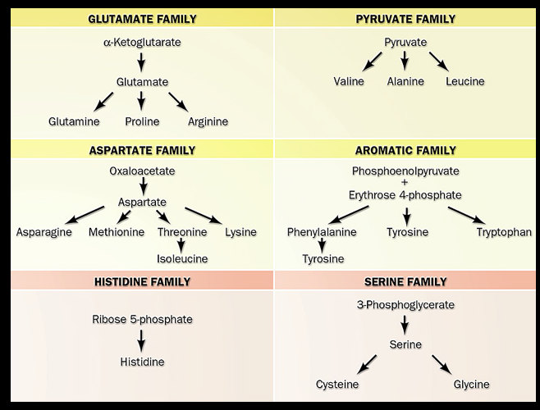

Slide 25
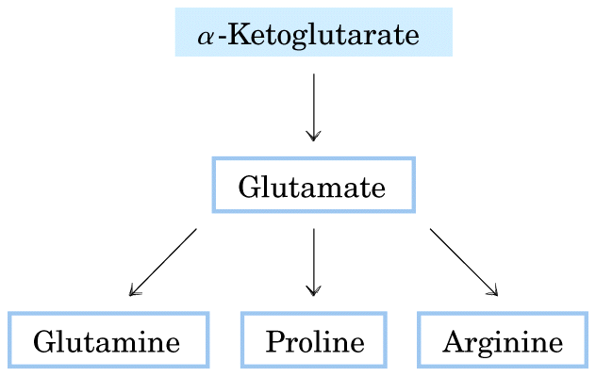

Slide 26
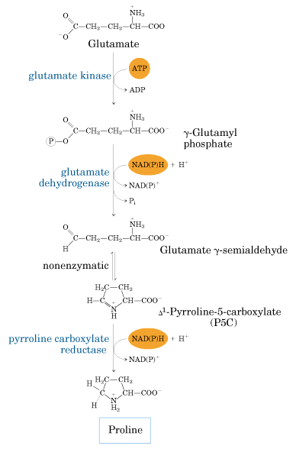

Slide 27
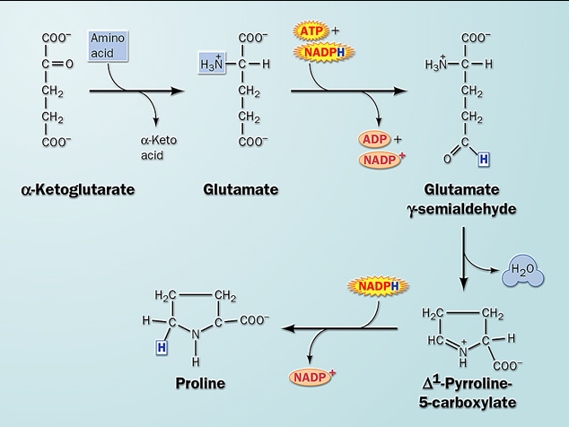

Slide 28
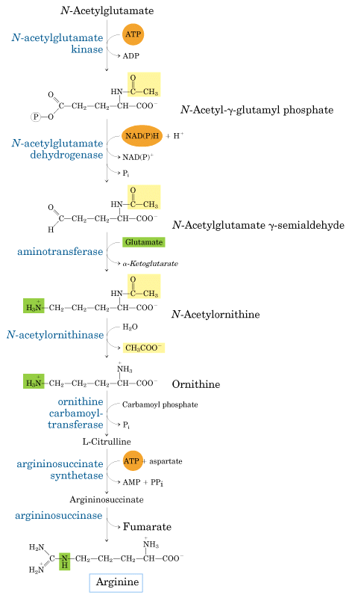
鸟氨酸

Slide 30
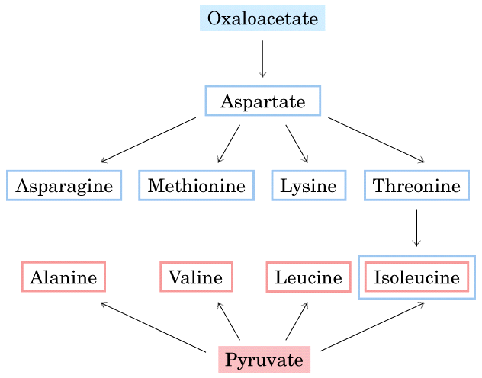

Slide 31
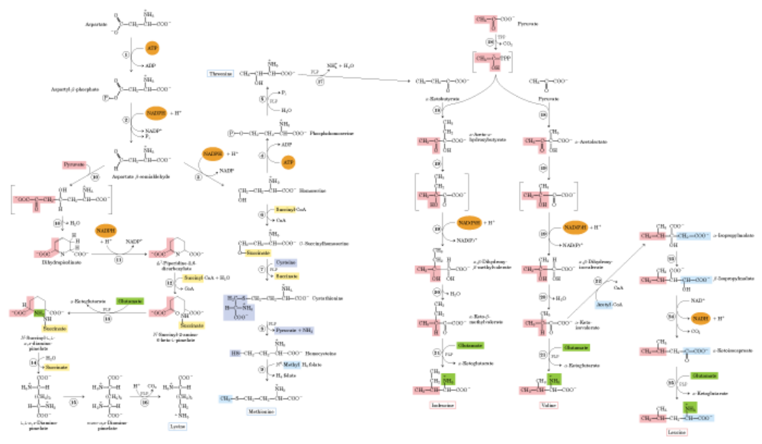
Aspartate
Pyruvate
Threonine
Isoleusine
Valine
Lysine
Methionine
Leusine

Slide 32
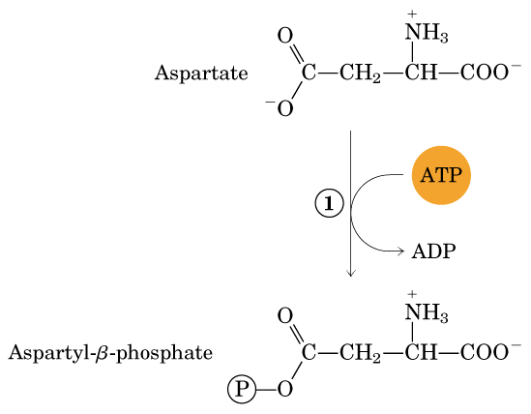
Step1-step 5
Asp Thr

Slide 33
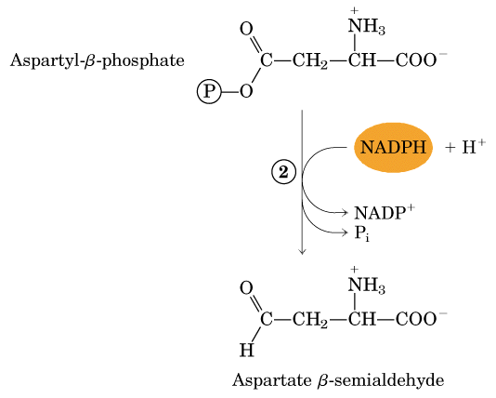

Slide 34
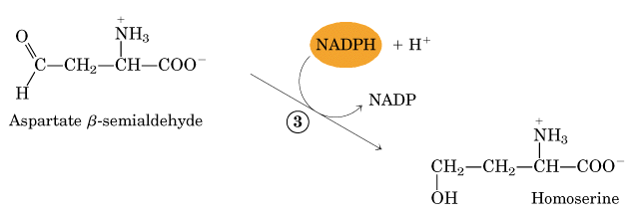

Slide 35
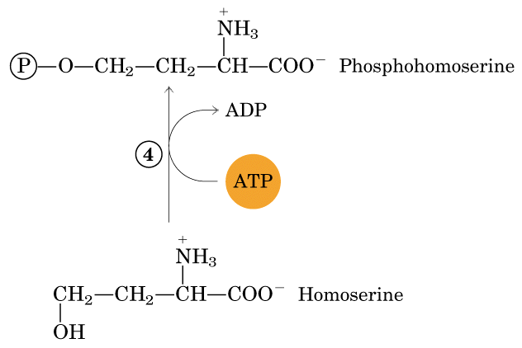

Slide 36
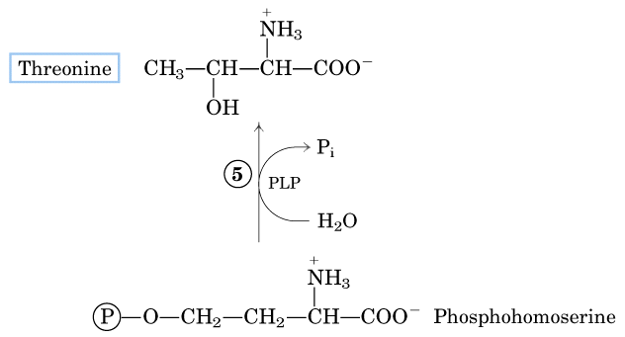

Slide 37
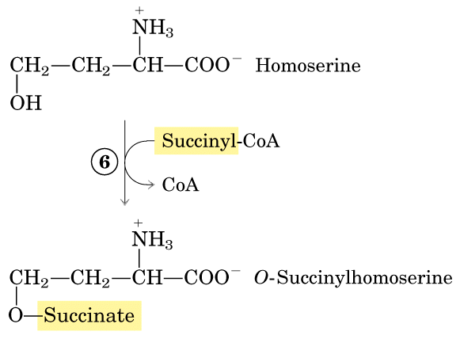
Step1-step 9
Asp Met

Slide 38
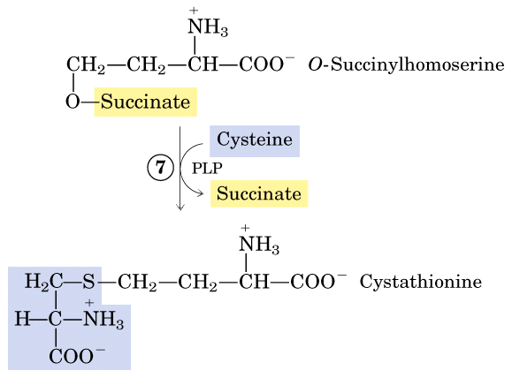

Slide 39
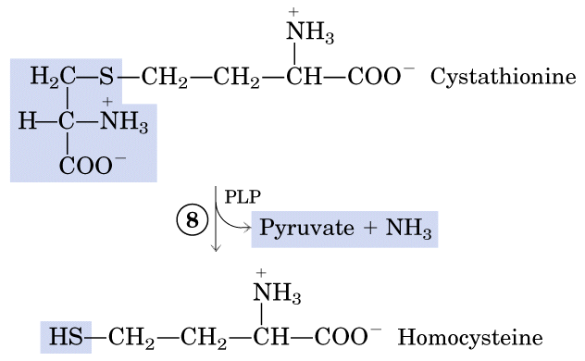

Slide 40
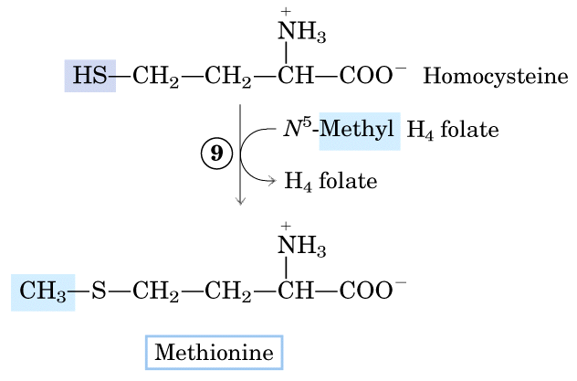

Slide 41
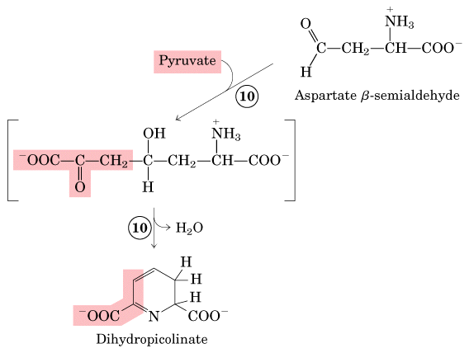
Product of step 2
Step10-step 16
Asp Lys

Slide 42
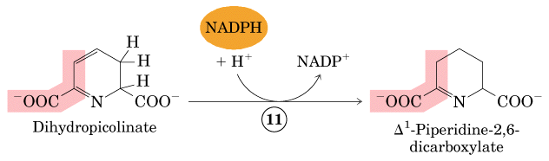

Slide 43
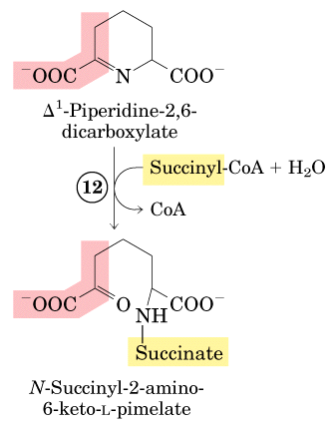

Slide 44
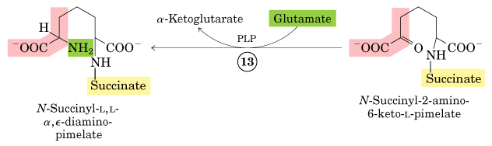

Slide 45
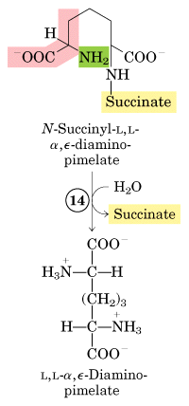

Slide 46
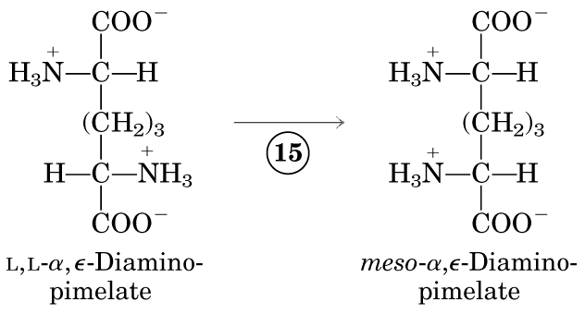

Slide 47
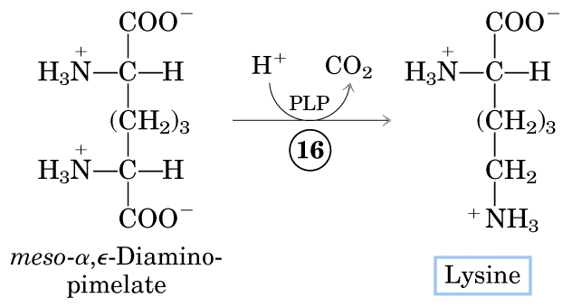

Slide 48
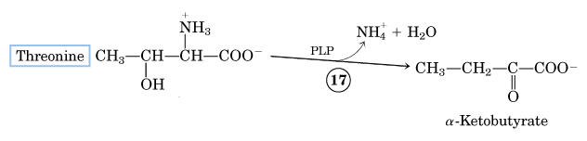
Synthesis of Ile Val Leu
Product of step 5

Slide 49
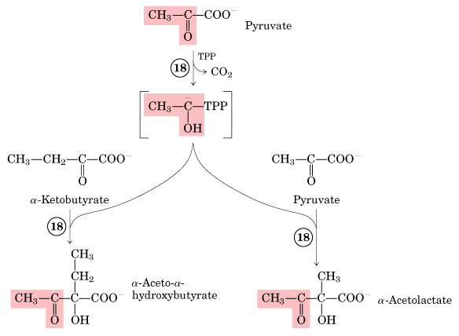
Synthesis of Ile Val Leu
Product of step 17

Slide 50
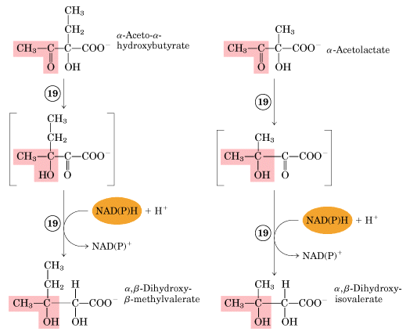

Slide 51
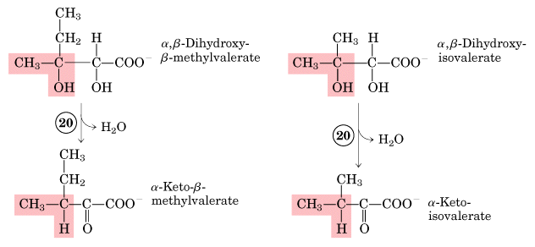

Slide 52
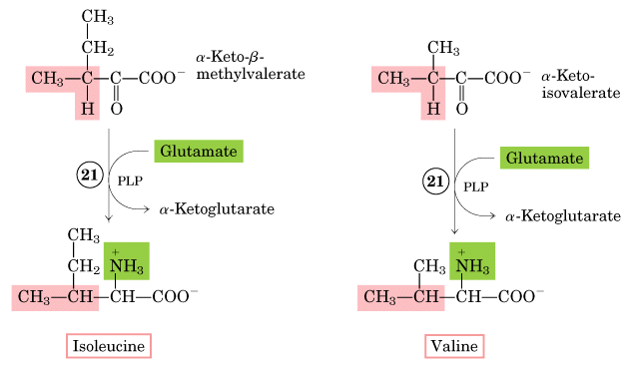

Slide 53
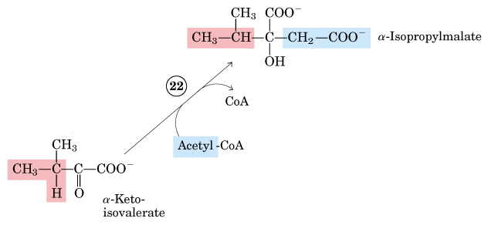
Product of step 20

Slide 54
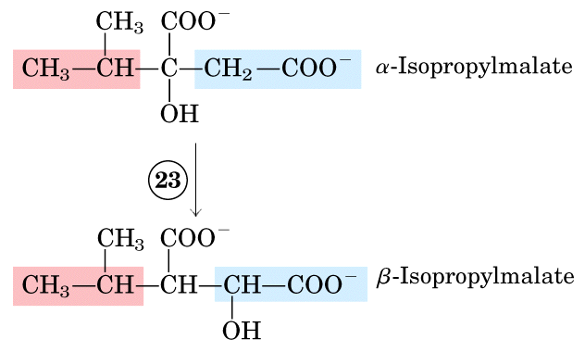

Slide 55
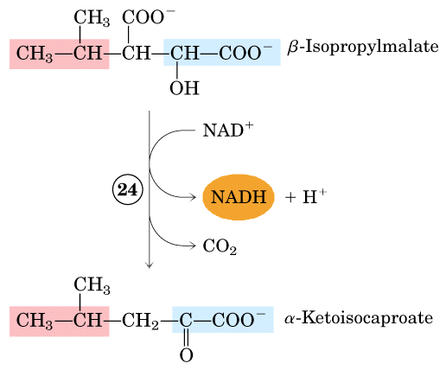

Slide 56


Slide 57
Aspartate family and Pyruvate family

Slide 58


Slide 59


Slide 60


Slide 61


Slide 63


Slide 64

一碳集团（代谢）：在代谢过程中，某些化合物可以分解产生具有一个碳原子的集团，称为一碳基团，辅酶是FH4/THF （四氢叶酸）。
Next

Slide 65


Slide 66


Slide 67


Slide 68


Slide 69


Slide 70


Slide 71

Next

Slide 72


Slide 73


Slide 75

莽草酸

Slide 76
PEP
E – 4 – P
莽草酸 分枝酸
色氨酸 苯丙氨酸 酪氨酸
Next

Slide 77


Slide 78


Slide 79


Slide 80

莽草酸

Slide 81


Slide 82


Slide 83

分枝酸

Slide 84


Slide 85


Slide 86


Slide 87


Slide 88


Slide 89


Slide 90
Only about half of the amino acids can be synthesized by us human being: the rest have to be obtained from diet, thus called essential amino acids.

Slide 91


Slide 92


Amino Acids
that can not be
synthesized by
human (essential
Amino acids)
9种人体必需氨基酸的简单
记忆方法：
“甲组携来一本亮色书”
就是甲硫氨酸、组氨酸、
缬氨酸、赖氨酸、
异亮氨酸、苯丙氨酸、
亮氨酸、色氨酸、苏氨酸

Slide 93
Amino acids are precursors of many specialized biomolecules

Slide 94

Porphyrins in mammals
are made from Gly and
succinyl-CoA.

Slide 95
Phosphocreatine, derived from creatine. Creatine is synthesized from glycine and arginine; methionine, in the form of SAM.
Phenylalanine, tyrosine, and tryptophan are converted to a variety of important compounds in plants. lignin, derived from phenylalanine and tyrosine; Tryptophan is also the precursor of the plant growth hormone indole-3-acetate, or auxin.
Nitric oxide is synthesized from arginine in an NADPH-dependent reaction catalyzed by nitric oxide synthase in animals.

Slide 96
M2
Amino acid degradation

Slide 97
氨基酸的分解与转化
1.脱氨基作用
2.脱羧基作用
3.氨基酸分解产物的转化

Slide 98
氨基酸的脱氨基作用
氧化脱氨基作用
转氨脱氨基作用
联合脱氨基作用
非氧化脱氨基作用
脱酰氨作用

Slide 99
The surplus amino acids in animals can be completely oxidized or converted to other storable fuels
Amino acids in excess can neither be stored, nor excreted, but oxidized to release energy or converted to fatty acids/glucose.
Animals utilize amino acids for energy generation following a protein meal, during starvation.
Microorganisms can also use amino acids as an energy source when the supply is in excess.
Plants almost never use amino acids (neither fatty acids) as an energy source.

Slide 101

This reaction is fully reversible!
Aminotransferase
or transaminase
Pyridoxal phosphate (PLP)
The α-amino group of many amino acids
is transferred to α-ketoglutarate
via catalysis of a specific aminotransferase,
producing Glu and an α-keto acid.

Slide 102


Slide 103
The major route for the deamination of amino acids is transamination followed by the oxidative deamination of glutamate. （联合脱氨基）
However, a minor route also exists that involves direct oxidation of the amino acid by L-amino acid oxidase.

Slide 104
脱氨基产物α-酮酸的代谢转变
（1）再氨基化生成氨基酸
（2）转变成糖或脂肪
生糖氨基酸和生酮氨基酸
（3）氧化成CO₂和H₂O

Slide 105
Trp, Ala, Gly, Ser, Cys are converted
to pyruvate
(thus being glucogenic生糖氨基酸)
Part of Trp, Phe, Tyr, Leu & Lys are converted to acetoacetyl-CoA, and Part of Trp, Leu, and Ile is converted to acetyl-CoA.
(thus being ketogenic生酮氨基酸)

Slide 106
2.氨基酸的脱羧基作用
氨基酸在脱羧酶的
作用下脱掉羧基生成相
应的一级胺类化合物
的作用。脱羧酶的辅
酶为磷酸吡哆醛(Pyridoxal
phosphate;PLP)。
概念
直接脱羧 胺
羟化脱羧 羟胺
类型:
脱羧产物的进一步转化（次生物质代谢）

Slide 107
（1）直接脱羧作用
脱羧酶（辅酶为磷酸吡哆醛/胺）
Glu→氨基丁酸（GABA）
His→组胺
Trp→5羟色胺
Cys→牛磺酸
Orn→多胺(腐胺、精脒、精胺)
腐败细菌作用时，常发生此类脱羧反应，生成胺类
Next

Slide 108
γ-氨基丁酸
COOH
|
(CH₂)₂ COOH
| L-谷氨酸脱羧酶 |
CH-NH₂ (CH₂)₂
| CO₂ |
COOH CH₂NH₂
L- 谷氨酸 γ-氨基丁酸
γ-氨基丁酸:γ-aminobutyric acid, GABA
抑制性神经递质

Slide 109
组胺
组氨酸脱羧酶
HC=C-CH₂CHCOOH HC=C-CH₂CH₂NH₂
| | | CO₂ | |
HN N NH₂ HN N
C C
H H
L-组氨酸 组胺
组胺：血管舒张剂、胃酸刺激剂

Slide 110

4

Slide 111


5
促进细胞增殖

Slide 112
羟化脱羧基作用
羟化脱羧基作用
酪氨酸 二羟苯丙氨酸（多巴）
二羟苯乙胺（多巴胺）
1/2O₂
酪氨酸羟化酶
CO₂
氧化
白化病
黑素
生物碱
帕金森病

Slide 113
3.氨基酸分解产物的转化
（1）氨的代谢转变
（2）氨基酸碳骨架的代谢途径

Slide 114
（1）氨的代谢转变
重新生成氨基酸
谷氨酰胺和天冬酰氨的生成
合成其他含N物质
尿素的生成、及直接排氨

Slide 115
a、谷氨酸的重新生成
L-谷氨酸脱氢酶
α-酮戊二 酸+ NH₃
谷氨酸+ H₂O
NAD(P)H
NAD(P)⁺

Slide 116

谷氨酰胺的生成和利用
b、谷氨酰胺和天冬酰氨的生成
ATP ADP+Pi
Mg²⁺
+NH₃
+H₂O
谷氨酰胺合成酶
c、生成铵盐
与柠檬酸、苹果酸、草酰乙酸等生成铵盐，保持细胞内正常的pH

Slide 117
D The Urea Cycle
Excess nitrogen is excreted as ammonia. Ammonotelic (排氨的)organisms excrete ammonia directly, uricotelic (排尿酸的) organisms excrete it as uric acid, and ureotelic(排尿的) organism excrete it as urea.

Slide 118
尿 素 的 生 成
a、概念
在排尿动物体内由
NH₃合成尿素是在肝脏
中通过鸟氨酸循环机制完
成的，这一个循环称为
尿素循环。
b、总反应和过程
NH₃+CO₂+3ATP+天冬氨酸+2H₂O → NH₂-CO-NH₂
+ 2ADP +2+ AMP +PPi+延胡索酸

Slide 119


鸟氨酸循环
氨基酸
O
谷氨酸
胞液
NH2-C-NH2
谷氨酸
尿素
鸟氨酸
2ATP+CO₂+NH₃+H₂O
5
1
H₂O
鸟氨酸
2ADP+Pi
精氨酸
氨甲酰磷酸
线粒体
2
延胡索酸
4
瓜氨酸
精氨琥珀酸
3
AMP+PPi
基质
ATP
瓜氨酸
天冬氨酸
α-酮戊二酸
草酰乙酸
谷氨酸
氨基酸
氨甲酰磷酸

Slide 120
Summary
Nitrogen fixation：Atmospheric N₂ is reduced to ammonia by the dinitrogenase reductase and the dinitrogenase (containing a key Fe-Mo cofactor) of the nitrogenase complex present only in certain bacteria.
Ammonia assimilation：Ammonia enters organic molecules via Glu (glutamate dehydrogenase, glutamate synthase) and Gln (glutamine synthetase).
Glutamine/Glutamate aminotransferases catalyzes the transferring of the amino group to many acceptor molecules.

Slide 121
For Biosynthesis
Amino acids are mainly derived from intermediates of glycolysis, the citric acid cycle, and the pentose phosphate pathway.
Pro and Arg are derived from Glu, which is synthesized from α-ketoglutarate.
Ser, Gly, and Cys are derived from 3-phosphoglycerate.
Met and Thr are derived from oxaloacetate.
Lys and Ile are derived from oxaloacetate and pyruvate.

Slide 122
Val and Leu are derived from pyruvate.
Ile and Val are derived from Thr/pyruvate and two molecules of pyruvate respectively, using the same enzymes; Leu is derived from two molecules of pyruvate, sharing four steps of reactions with Val synthesis.
Tryptophan is derived from phosphoenolpyruvate, erythrose 4-P, Gln, PRPP, and one Ser.
Phe and Tyr are synthesized from two phosphoenolpyruvates, one erythrose 4-P （ shikimate 莽草酸）, and one Glu.

Slide 123
For Degradation
Amino acid in excess can neither be stored, nor excreted, but oxidized or converted.
The amino groups and carbon skeletons of amino acids take separate but interconnected pathways.
Glutamate collects and delivers free ammonia（转氨基作用）.
Gln and Glu releases NH₄⁺ in mitochondria（氧化脱氨基作用）.

Slide 124
END
Thank you

